Slide 1

“welcome to our presentation”
Our Team :
1. Lê Quang Long - 20IT011
2. Nguyễn Thị Lâm Anh - 20IT028

Slide 2
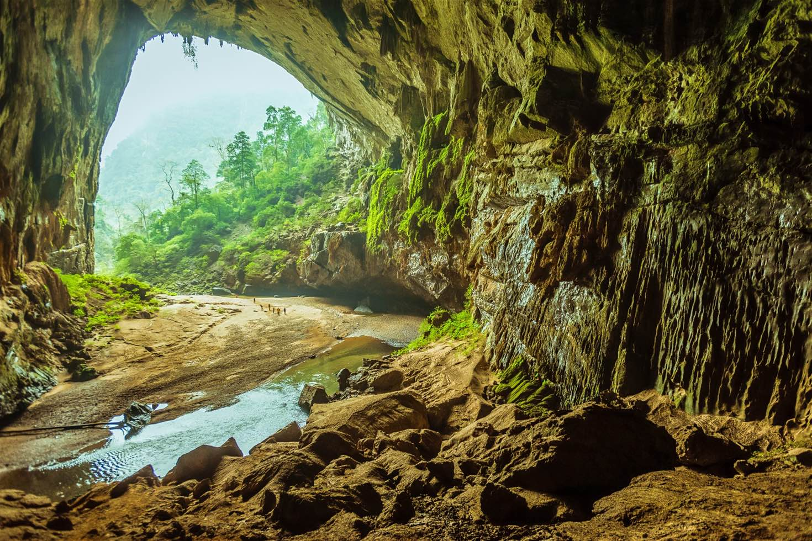
APP MOBILE
OXALIS

Slide 3
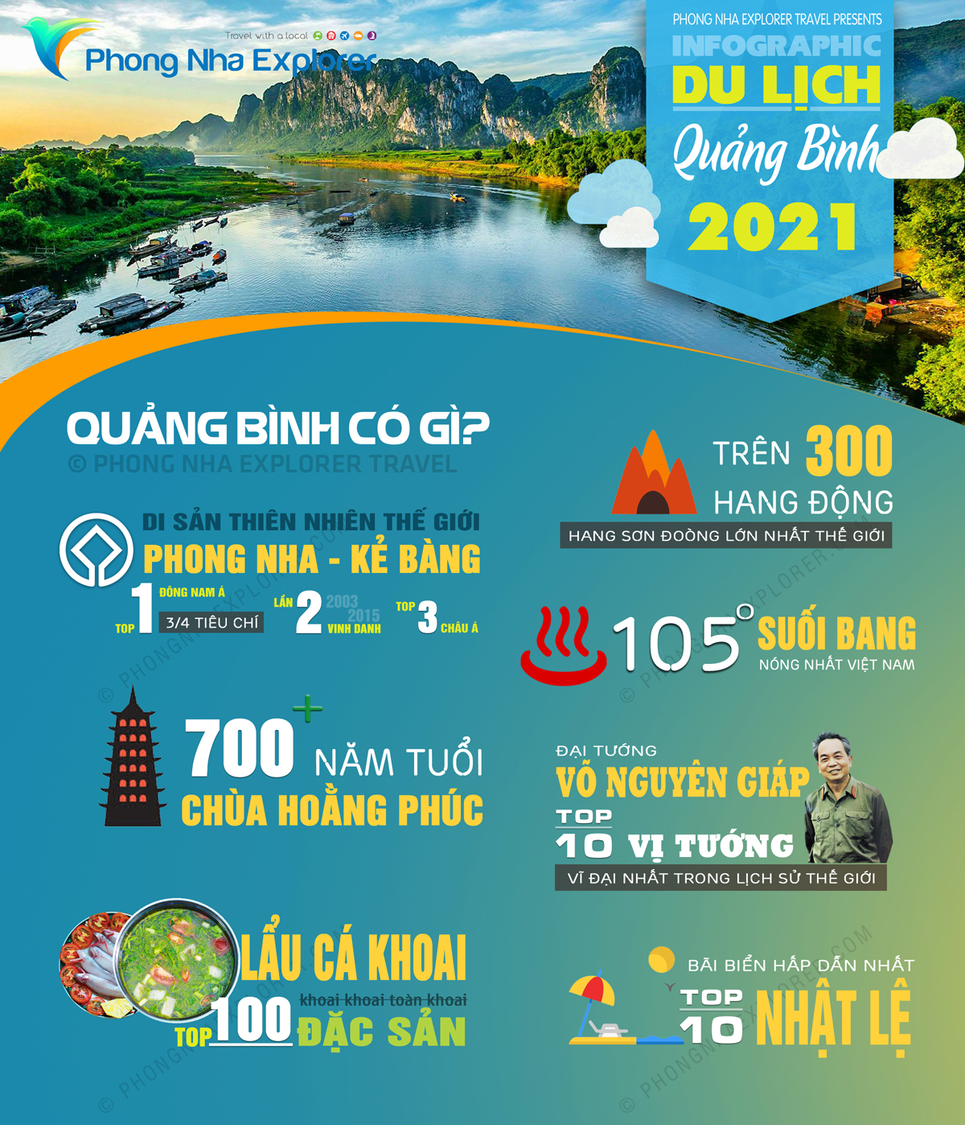
contents
01
02
03
04
introduce
system analysis and design
conclusion
Demo APP

Slide 4

01. INTRODUCTION

Slide 5
Reasons for choosing the topic
1.
The development of e-commerce.
2.
The need to travel and the preferences of people to explore.
3.
The development of tourism in Vietnam.

Slide 6

WHY WE CHOOSE QUANG BINH ?

Slide 7
— Design IDEAS —

Slide 8
Problems need to be sloved
- Build travel application with friendly interface, easy to use, fast speed.
- Introduce details about the tour, help customers find the right tour, quickly.
- The content and presentation of the application must be concise, clear and easy to understand.
- Assist customers with all queries.
- Compatible with all popular Android devices on the market.

Slide 9
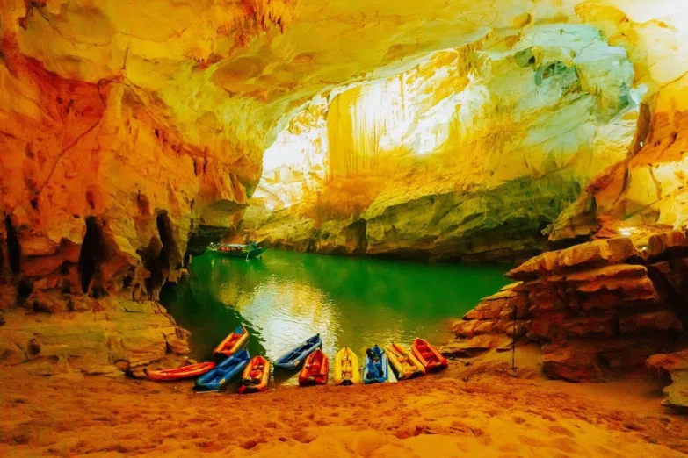
02. system analysis and design

Slide 10

Language used
KOTLIN

Slide 11

Design software
ANDROID STUDIO

Slide 12
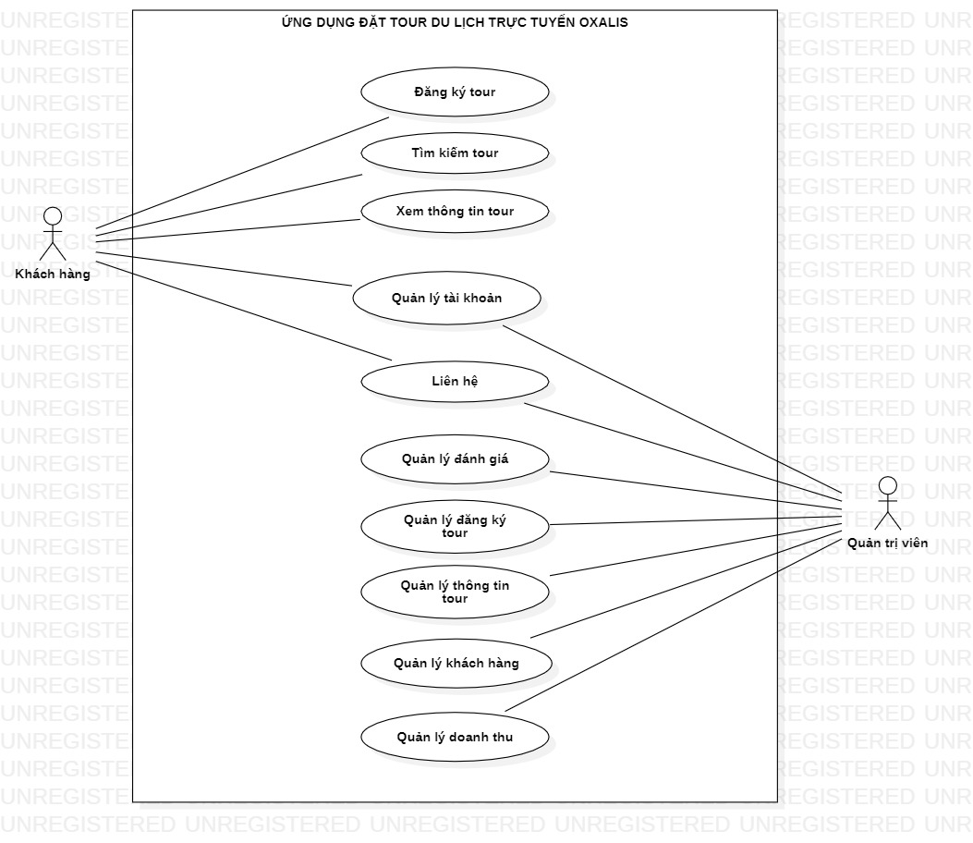
USE-CASE DIAGRAM

Slide 13
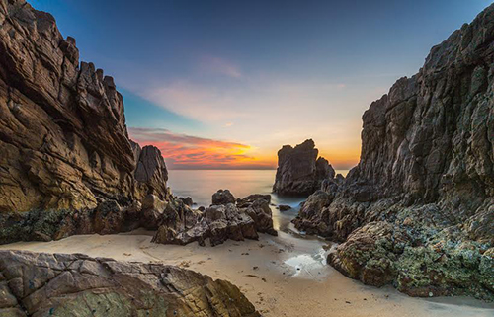
03. conclusion

Slide 14


Advantages
disadvantages
- Simple application interface, easy to use.
- Already have a database system.
- Vivid, sharp images.
- Fast page loading speed.
- The application is compatible with any Android device.
- Easy upgrade facility in the future.
- The interface is not optimized and modern.

Slide 15

04. DEMO app

Slide 16
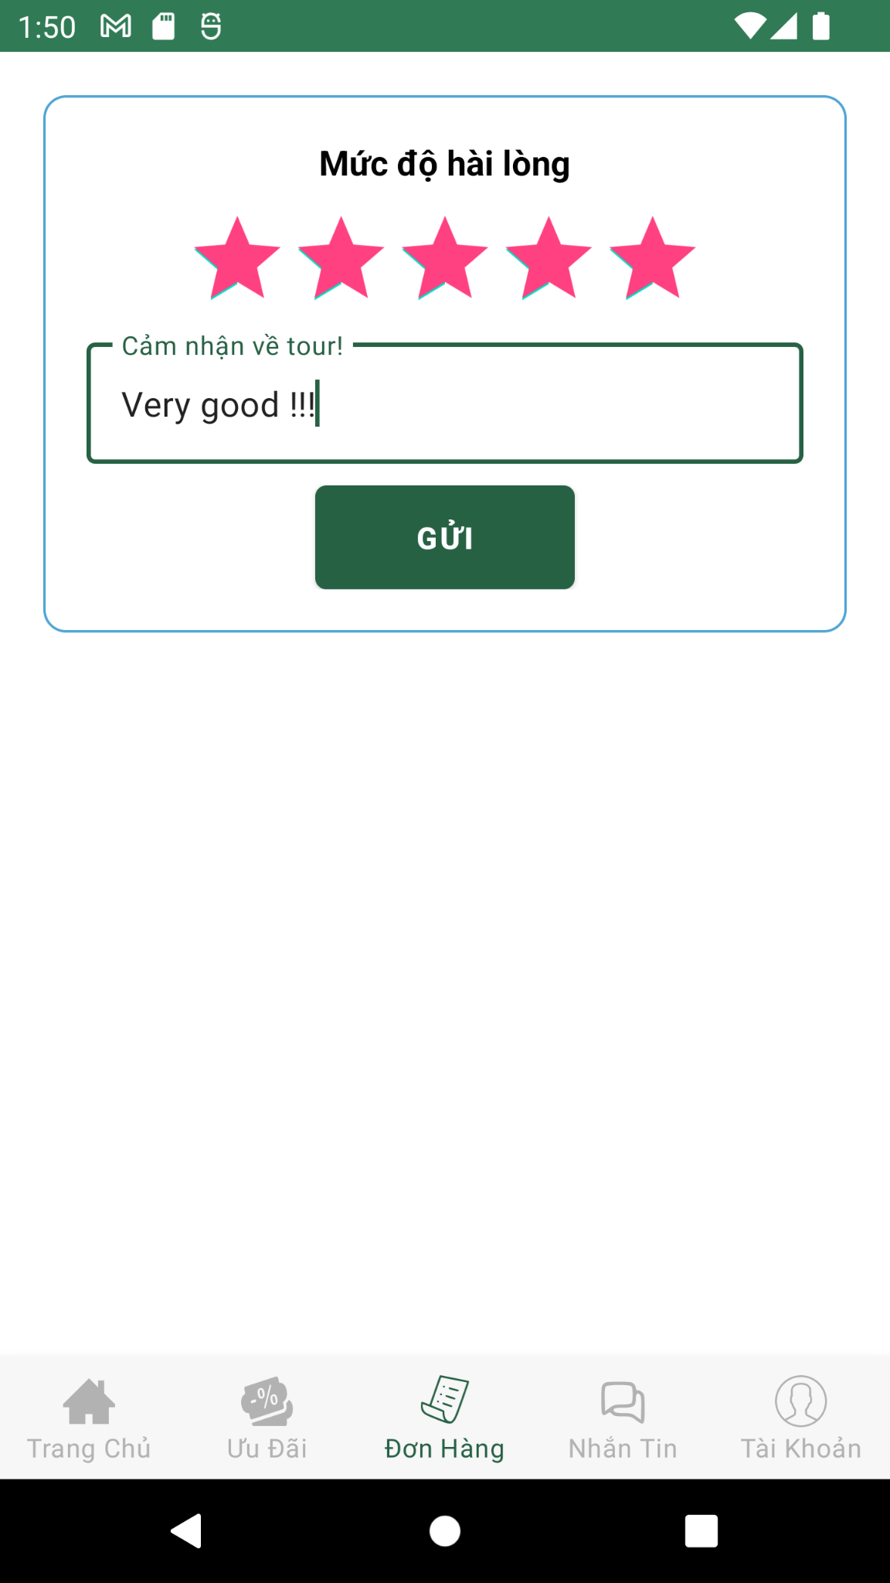
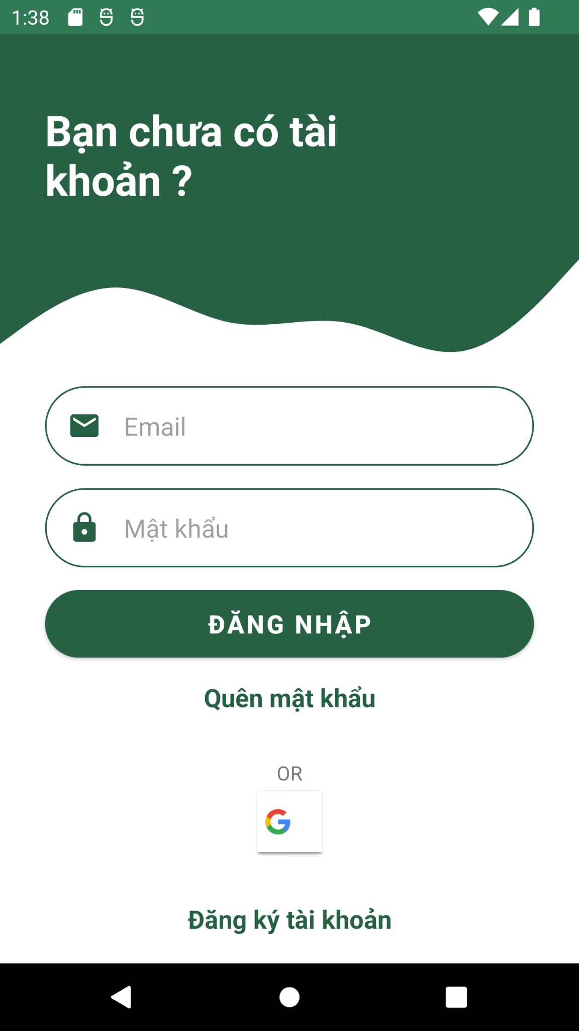
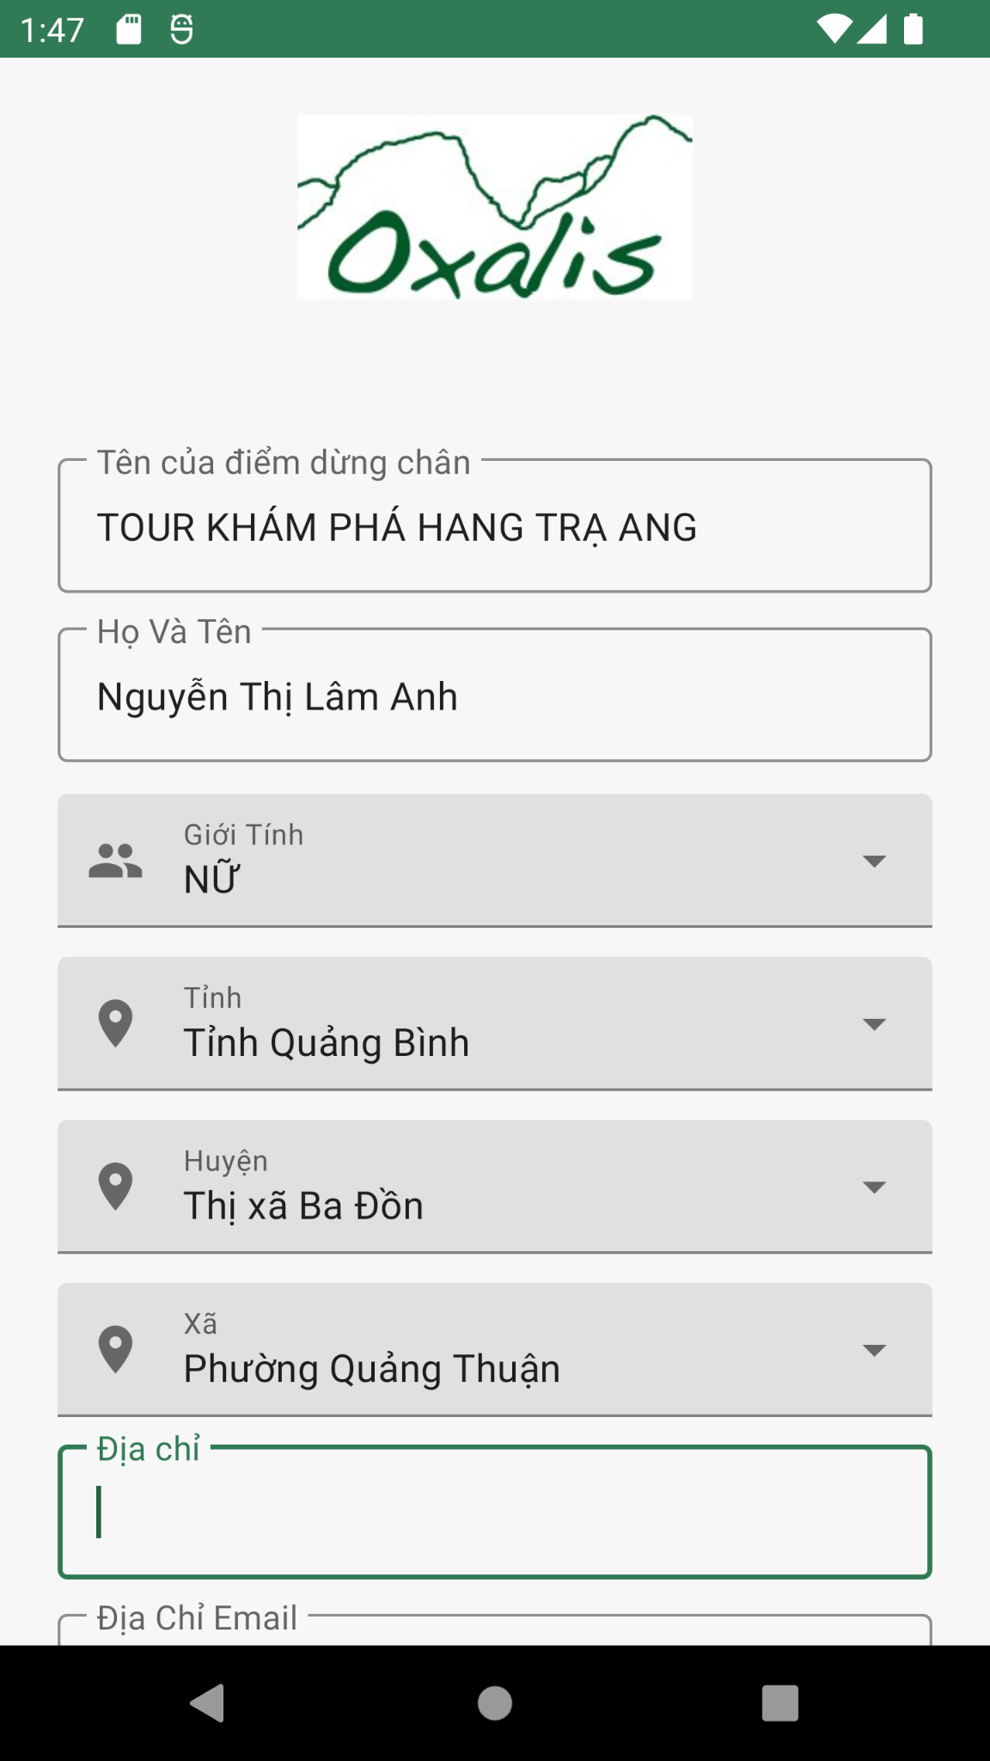
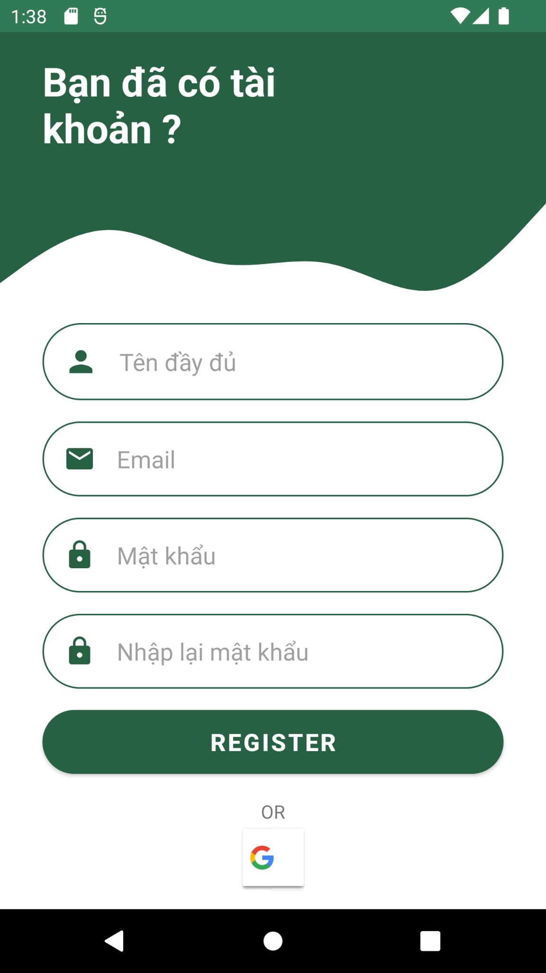
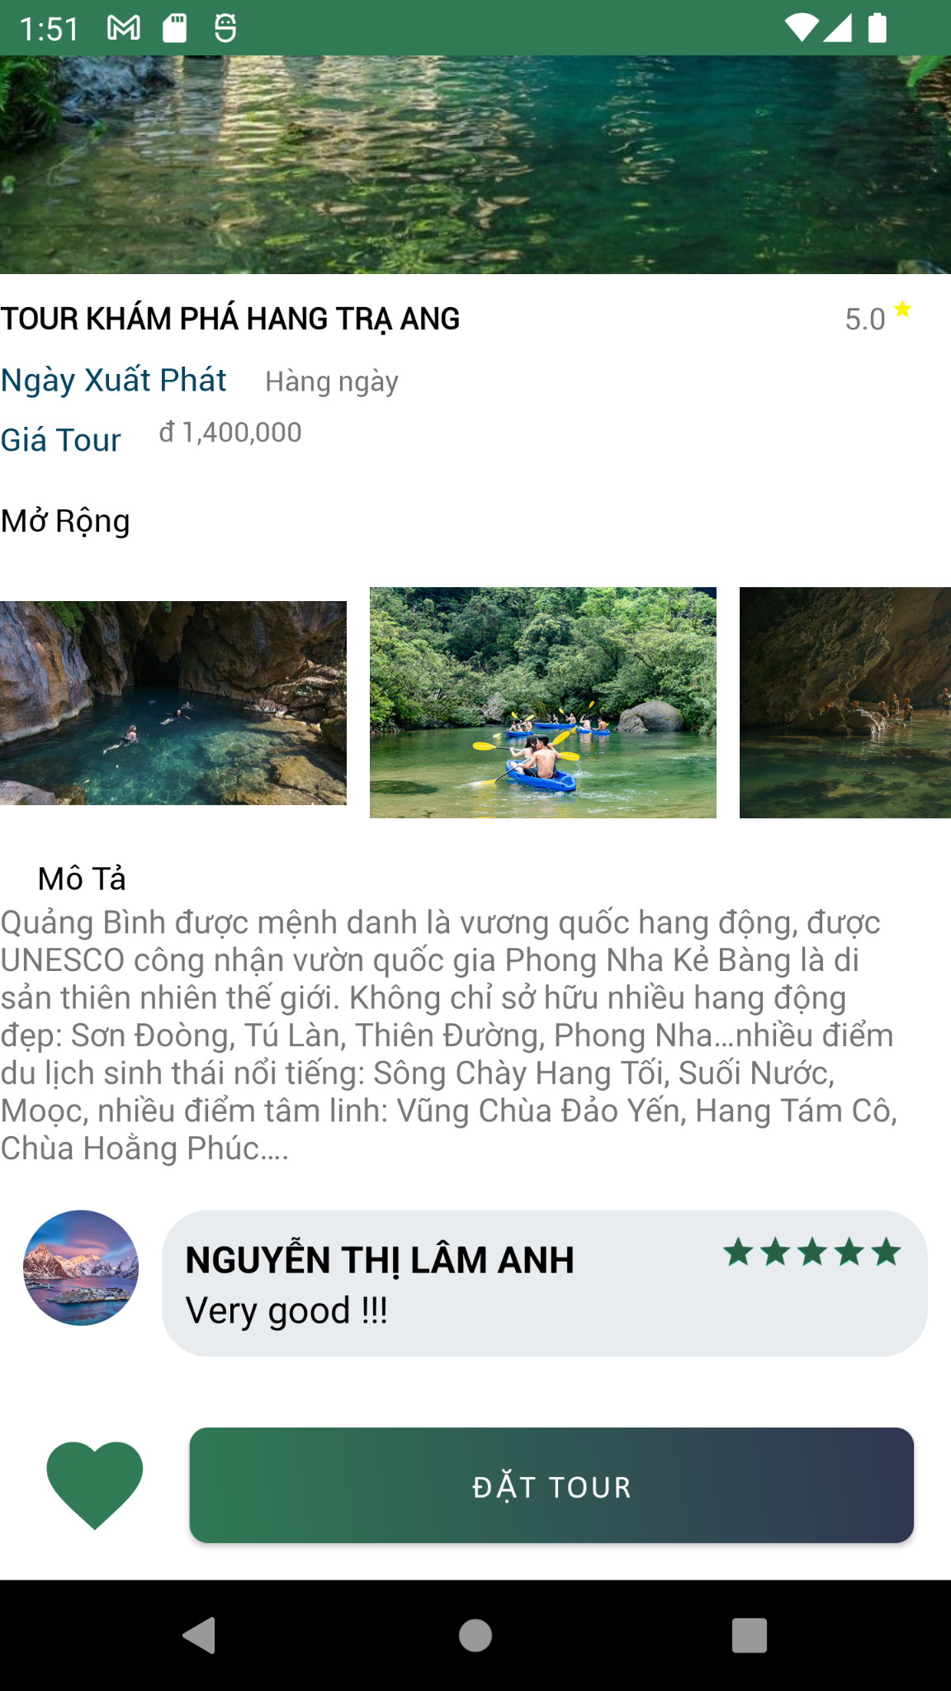
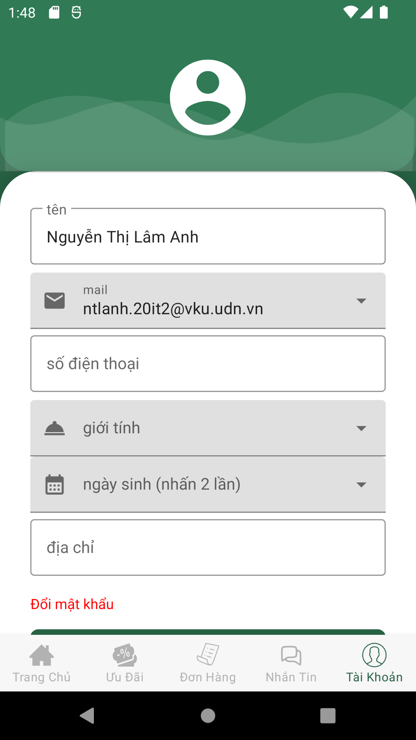
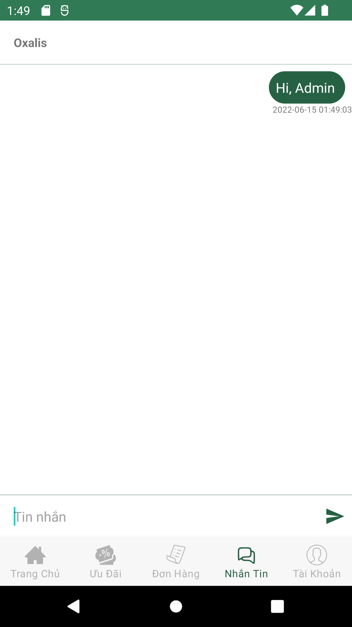
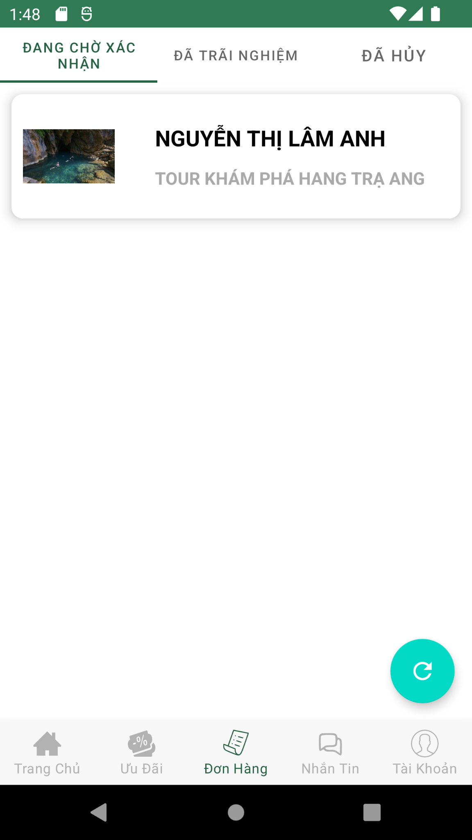
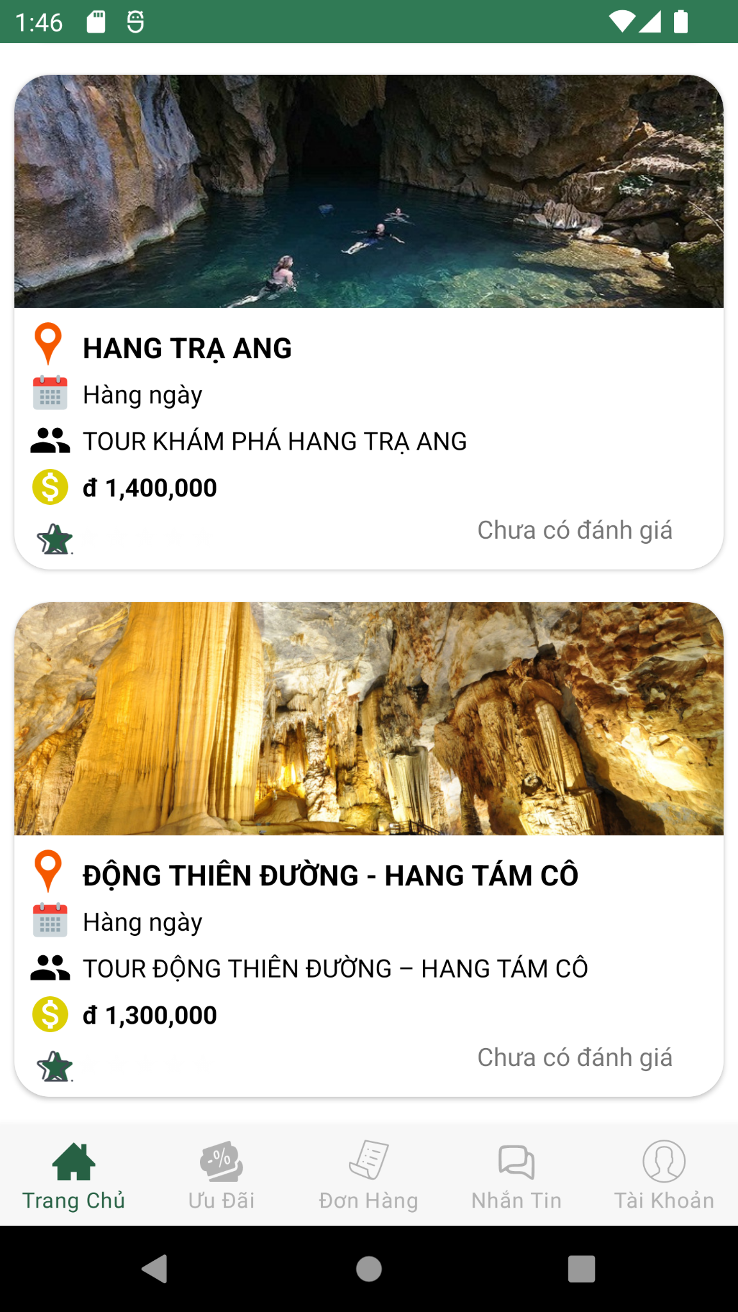
Functional of app
USER
1. Search tour
2. Book tour
3. Register, login
4. Update personal information
5. See tours status
6. Tour reviews
7. Live chat with Admin

Slide 17
Functional of app
Admin
1. Search tour
2. Book tour
3. Register, login
4. Update personal information
5. See tours status
6. Live chat with Admin

Slide 18

THANKS !
Do you have any questions?

